Slide 1
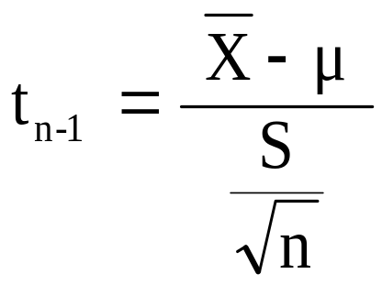

t Test of Hypothesis for the Mean (σ Unknown)
Hypothesis
Tests for μ
σ Known
σ Unknown
σ Unknown
(Z test)
(t test)
The test statistic is:
Convert sample statistic ( ) to a t test statistic
$$\overline{X}$$

Slide 2
Two-tail Test (σ Unknown)
Example:
The average cost of a hotel room in Sydney is said to be $168 per night. A random sample of 25 hotels resulted in an average of $172.50 and standard deviation of $15.40
Test at the α = 0.05 level.
(Assume the population distribution is normal)
H₀: μ = 168 H₁: μ ≠ 168

Slide 3
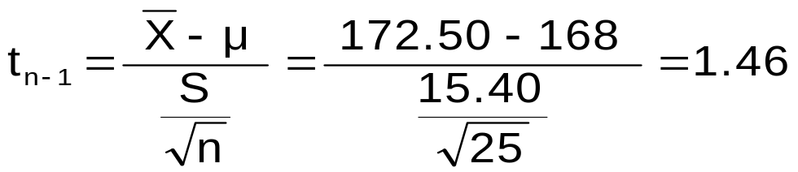
Two-tail Test (σ Unknown)
Example: (continued)
H₀: μ = 168
H₁: μ ≠ 168
α / 2=0.025
Do not reject H₀
α /2=0.025
α = 0.05
n = 25
σ is unknown, so use a t statistic
Critical value: t₂₄ = ± 2.0639
Reject H₀
Reject H₀
-t _{n-1,} α _{/2}
t _{n-1,α/2}
0
-2.0639
2.0639
1.46
Do not reject H₀: not sufficient evidence that true mean cost is different than $168

Slide 4
So far we’ve focussed on 2 tail tests.
Now lets look at One-tail Tests
The alternative hypothesis often focuses on a particular direction
H₀: μ ≥ 72
H₁: μ < 72
This is a lower-tail test since the alternative hypothesis is focused on the lower tail below the mean of 72
H₀: μ ≤ 72
H₁: μ > 72
This is an upper-tail test since the alternative hypothesis is focused on the upper tail above the mean of 72

Slide 5

Lower-tail Tests
H₀: μ ≥ 72
H₁: μ < 72
α
Do not reject H₀
Reject H₀
-Z
Z
0
μ
$$\overline{X}$$
There is only one critical value (in this case – Z), since the rejection region is in only one tail (the lower tail)

Slide 6
Upper-tail Tests
H₀: μ ≤ 72
H₁: μ > 72
α
Do not reject H₀
Reject H₀
+Z
Z
0
μ
X
There is only one critical value (in this case – Z), since the rejection region is in only one tail (the upper tail)

Slide 7
Upper-tail Z Test for Mean (σ Known)
Example:
A phone industry manager claims that customer monthly mobile phone bills have increased (in other words, the status quo has changed) and now average over $72 per month. The company wishes to test this claim
(Assume σ = 10 is known)
State H_{o} and H₁
H₀: μ ≤ 72 the average is not over $72 per month
H₁: μ > 72 the average is greater than $72 per month (i.e. sufficient evidence exists to support the manager’s claim)

Slide 8
Upper-tail Z Test for Mean (σ Known)
Example (continued):
Suppose that α = 0.10 is chosen for this test.
What is Z ?
Do not reject H₀
α = 0.10
0.90
Rejection region
Using the Standardized Normal Distribution Table, P(Z>1.28) ≈
1-P(Z<1.28) = 0.10
0
Z = 1.28
Reject H₀ if Z > 1.28

Slide 9
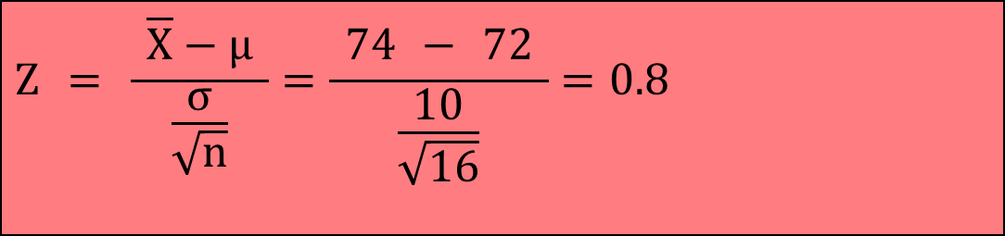
Upper-tail Z Test for Mean (σ Known)
Example (continued):
Obtain sample and calculate the test statistic
Suppose sample n = 16 is taken and sample mean is 74
Assume (σ=10 is known)
Then the test statistic is:
$$Z = \frac{ \overline{X}−μ }{\frac{σ}{\sqrt{n}}}=\frac{ \text{7}4 − \text{72} }{\frac{\text{10}}{\sqrt{\text{16}}}}=\text{0.8}$$

Slide 10
Upper-tail Z Test for Mean (σ Known)
Example (continued):
Reach a decision and interpret the result
α = 0.10
Do not reject H₀
Reject H₀
0
1.28
Z = 0.8
Do not reject H₀ since Z = 0.8 ≤ 1.28
i.e. there is not sufficient evidence that the
mean bill is over $72

Slide 11
p-value approach
As before we have Z=0.8, so what is P(Z≥0.8) ?
Look at the table =1- 0.78814=0.2119
p-value = 0.2119
Reject H₀
α = 0.10
Do not reject H₀
Reject H₀
0
1.28
Z = 0.8
Do not reject H₀ since p-value = 0.2119 > α = 0.10

Slide 12
Pitfalls and Ethical Considerations
Use randomly collected data to reduce selection biases or coverage errors
Do not use human subjects without informed consent
Choose the level of significance, α, and the type of test (one-tail or two-tail) before data collection
Do not employ ‘data snooping’ to choose between one-tail and two-tail test, or to determine the level of significance
Do not practice ‘data cleansing’ to hide observations that do not support a stated hypothesis
Report all pertinent findings
Distinguish between statistical significance vs. practical significance

